Slide 1
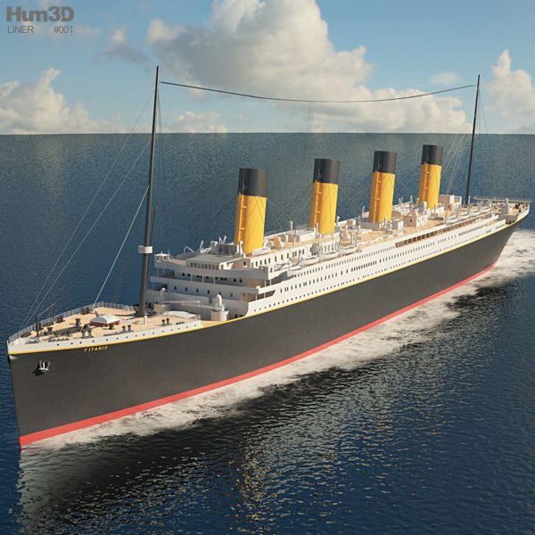
Titanic Data Analysis using Machine Learning
By Rose Yong

Slide 2
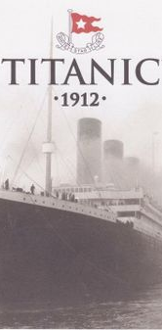
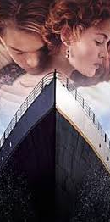
AGENDA
Introduction
Methodology
Process Workflow
Results
Conclusions
Future Opportunities

Slide 3
INTRODUCTION
Who are you?
Business Case
How will the prediction work help?
Competitor
Joining the Titanic ML competition organized by Kaggle
Use machine learning to build a predictive model that answers: “What sort of people were more likely to survive?” using the passenger data(ie name, age, sex, class etc).
The factors that made people more likely to survive the sinking Titanic.

Slide 4

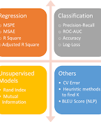
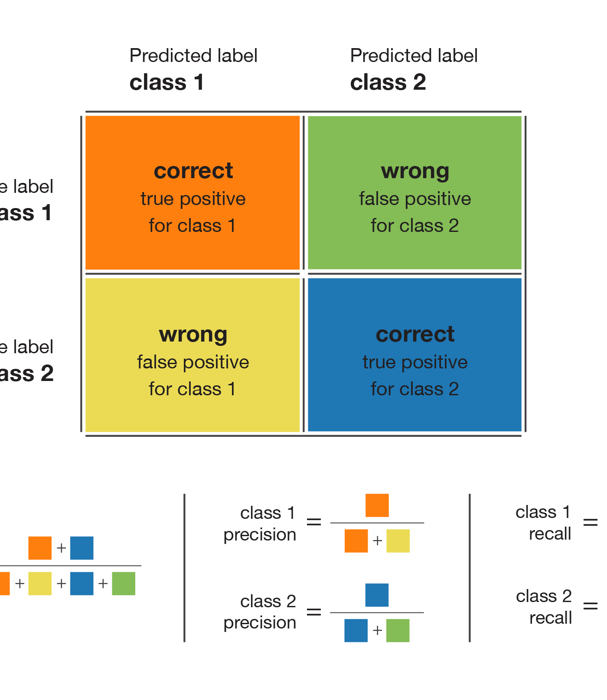

Methodology
Datasets
- Kaggle , 891 rows 12 columns
Models
- Logistic Regression - baseline
- Random Forests
- Decision Tree
Metrics
- Accuracy , Confusion Matrix, Recall,
-Precision, F1 score
Tools
- Scikit - Learn

Slide 5




Process workflow
Exploratory Data
Data Wrangling
Train & Test
Evaluation
Data using ML Model
Model for Accuracy
Analysis
Feature Engineering
5

Slide 6
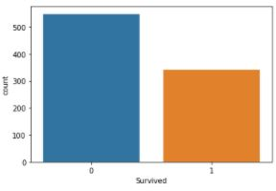
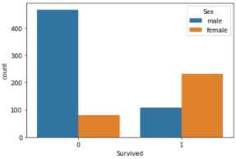
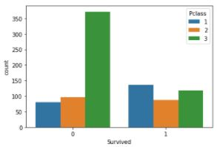
Exploratory Data Analysis
Survived
Sex
Passenger Class

Slide 7
Exploratory Data Analysis
Total passengers were 891, 577 (65%) are males and females are 314 (35%)
Only 342 (38%) passengers survived. Most survivor are females, 233 compared to males, 109.
Over 55% passengers are in Class 3,paying the lowest fare below $20, while 24% passengers in class 1 and the balance in class 2.
Majority of passengers in Class 3 are males and travel alone. Sadly, only less than 25% of them survived.
Passenger in class 1 were older than the rest and people in 3rd class were younger.
Women on port Q and on port S have a higher chance of survival
Notes:
ID=dd91c577-f997-49fe-a5eb-611d59b20eb8 Recipe=crop Type=Foreground Variant=0 FamilyID=ClassicFrameGoudy_Zero

Slide 8
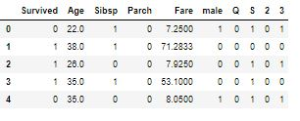
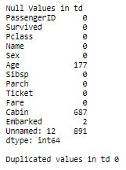
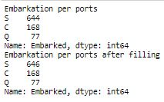
Data Wrangling
Process null and duplicate values
Fill in missing values
Create new features

Slide 9
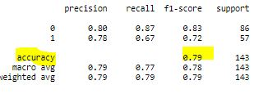
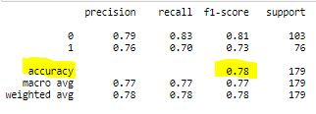
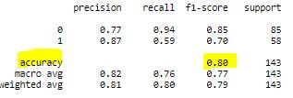
Results from ML model evaluation
Logistic Regression
Random Forest
Decision Tress

Slide 10
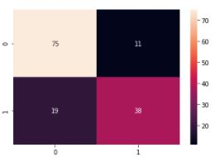
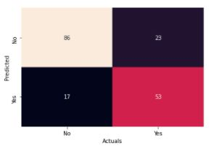
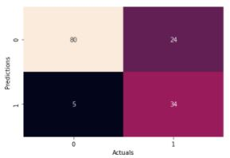
Results from ML model evaluation – Confusion matrix
Logistic Regression
Random Forest
Decision Tress

Slide 11
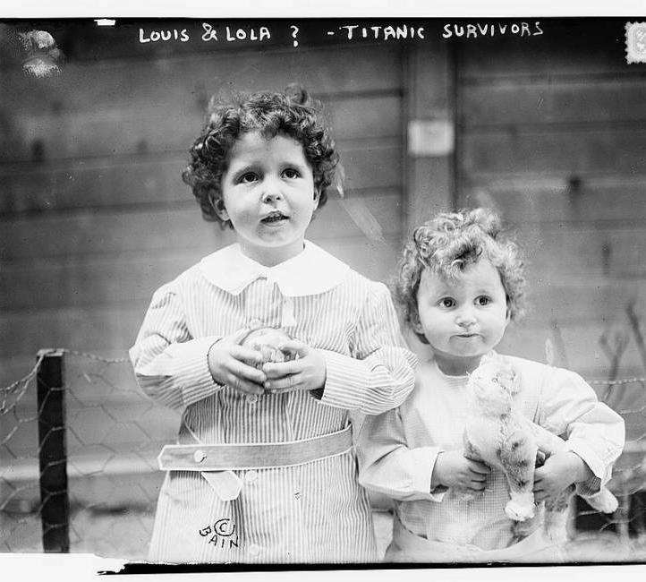
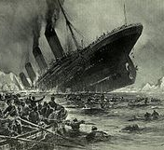
CONCLUSION
The likelihood of survival depends largely on the sex, passenger class and whether the passenger travel alone or with family.
Women and children, their chance of survival is very high especially those in Class 1 and Class 2 as most likely they are being saved by lifeboat.
Those people especially men who travel alone and staying in Class 3, most likely died either freezing at the sea or sinking together with Titanic ship.

Slide 12
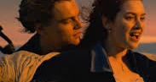

Future Opportunities
Apply the feature importance to Random Forest model to get a more higher accurate score.
Using other machine learning models for example Naïve Bayes, K-Nearest Neighbors .
The accuracy could be improved by tuning the hyper parameters of the classifier, adding new features.

Slide 13
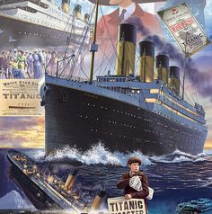
THANK YOU

